Slide 1
JSP Syntax and Examples

Slide 2
<html>
<head>
<title>Hello World</title>
</head>
<body> Hello World!<br/>
<% out.println("Your IP address is " + request.getRemoteAddr()); %>
</body>
</html>

Slide 3
<html>
<head>
<title>A Comment Test</title>
</head>
<body>
<p> Today's date: <%= (new java.util.Date()).toLocaleString()%>
</p>
</body>
</html>

Slide 4
<%! int day = 3; %>
<html>
<head>
<title>IF...ELSE Example</title>
</head>
<body>
<% if (day == 1 | day == 7)
{ %>
<p> Today is weekend</p>
<% }
else { %>
<p> Today is not weekend</p>
<% } %>
</body>
</html>

Slide 5
<%! int day = 3; %>
<html>
<head>
<title>SWITCH...CASE Example</title>
</head>
<body>
<% switch(day) {
case 0: out.println("It\'s Sunday.");
break;
case 1: out.println("It\'s Monday.");
break;
case 2: out.println("It\'s Tuesday.");
break;
case 3: out.println("It\'s Wednesday.");
break;
case 4: out.println("It\'s Thursday.");
break;
case 5: out.println("It\'s Friday."); break;
default: out.println("It's Saturday."); } %>
</body>
</html>

Slide 6
Let us look at the following for loop example:
<%! int fontSize; %>
<html>
<head>
<title>FOR LOOP Example</title>
</head>
<body>
<%for ( fontSize = 1; fontSize <= 3; fontSize++)
{ %>
<font color="green" size="<%= fontSize %>"> JSP Tutorial </font>
<br />
<%}%>
</body>
</html>

Slide 7
Above example can be written using while loop as follows:
<%! int fontSize; %>
<html>
<head>
<title>WHILE LOOP Example</title>
</head>
<body>
<%while ( fontSize <= 3){ %>
<font color="green" size="<%= fontSize %>"> JSP Tutorial </font> <br />
<%fontSize++;%>
<%}%>
</body>
</html>

Slide 8
JSP Operators:
JSP supports all the logical and arithmatic operators supported by Java. Following table give a list of all the operators with the highest precedence appear at the top of the table, those with the lowest appear at the bottom. Within an expression, higher precedence operators will be evaluated first.

Slide 9
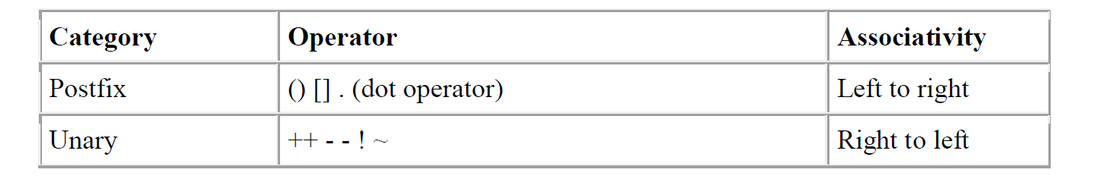

Slide 10
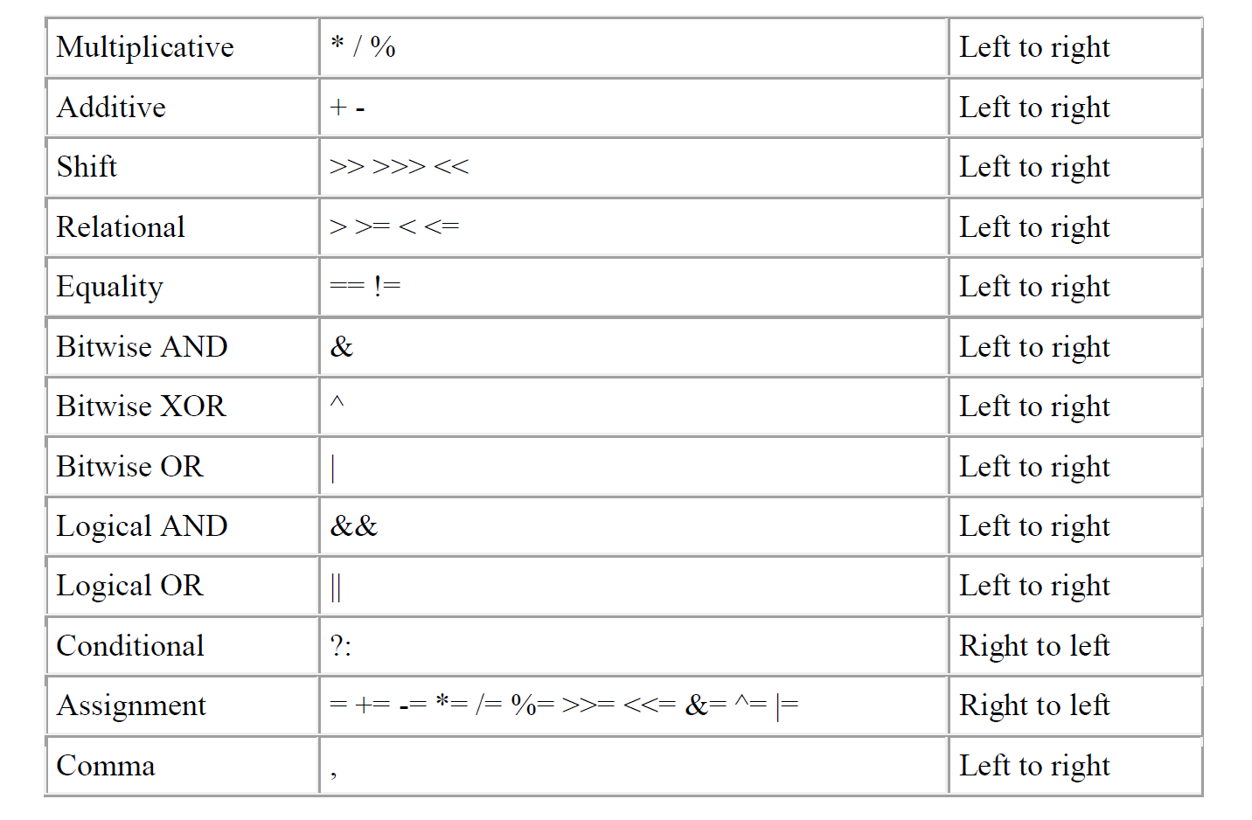

Slide 11
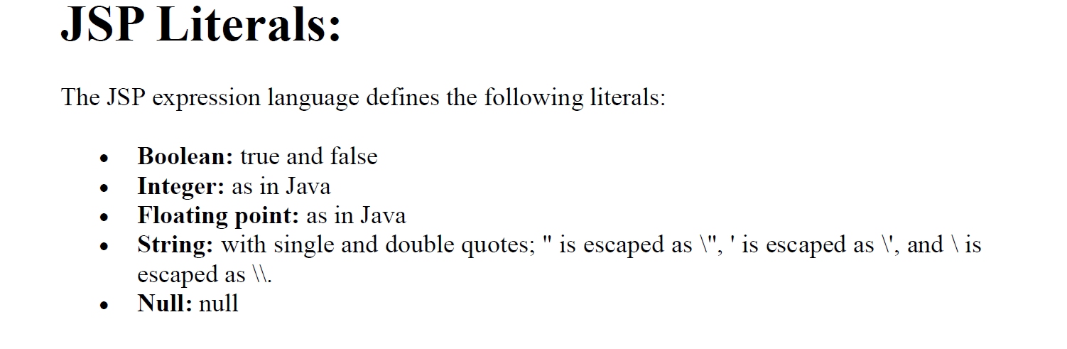

Slide 12
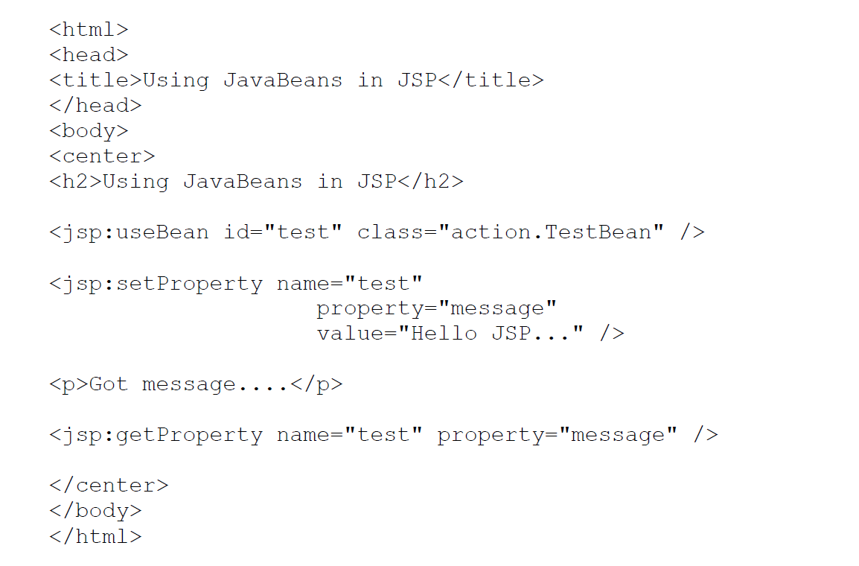

Slide 13
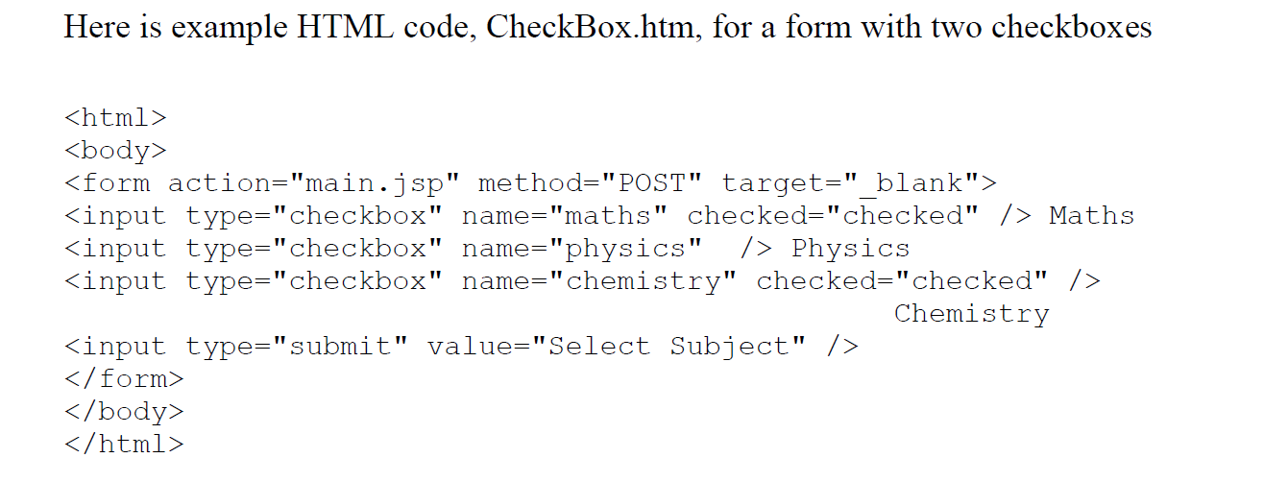

Slide 14
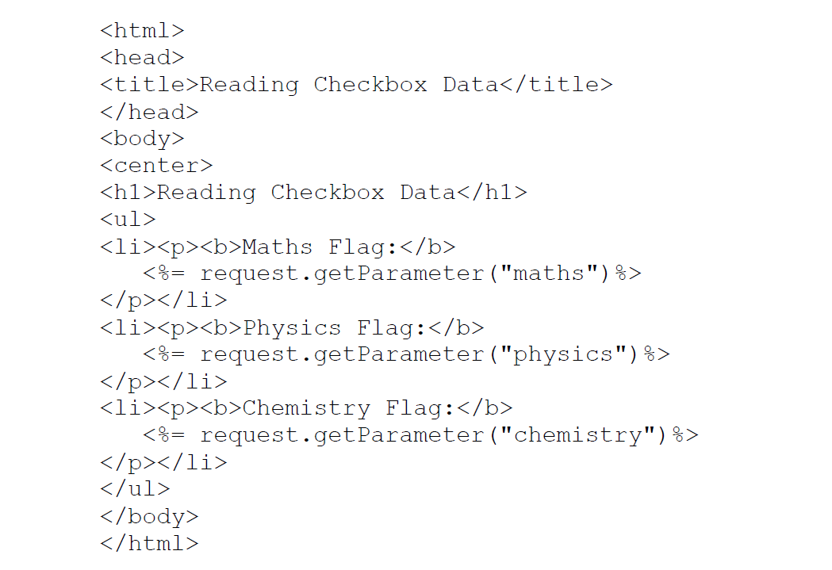

Slide 16
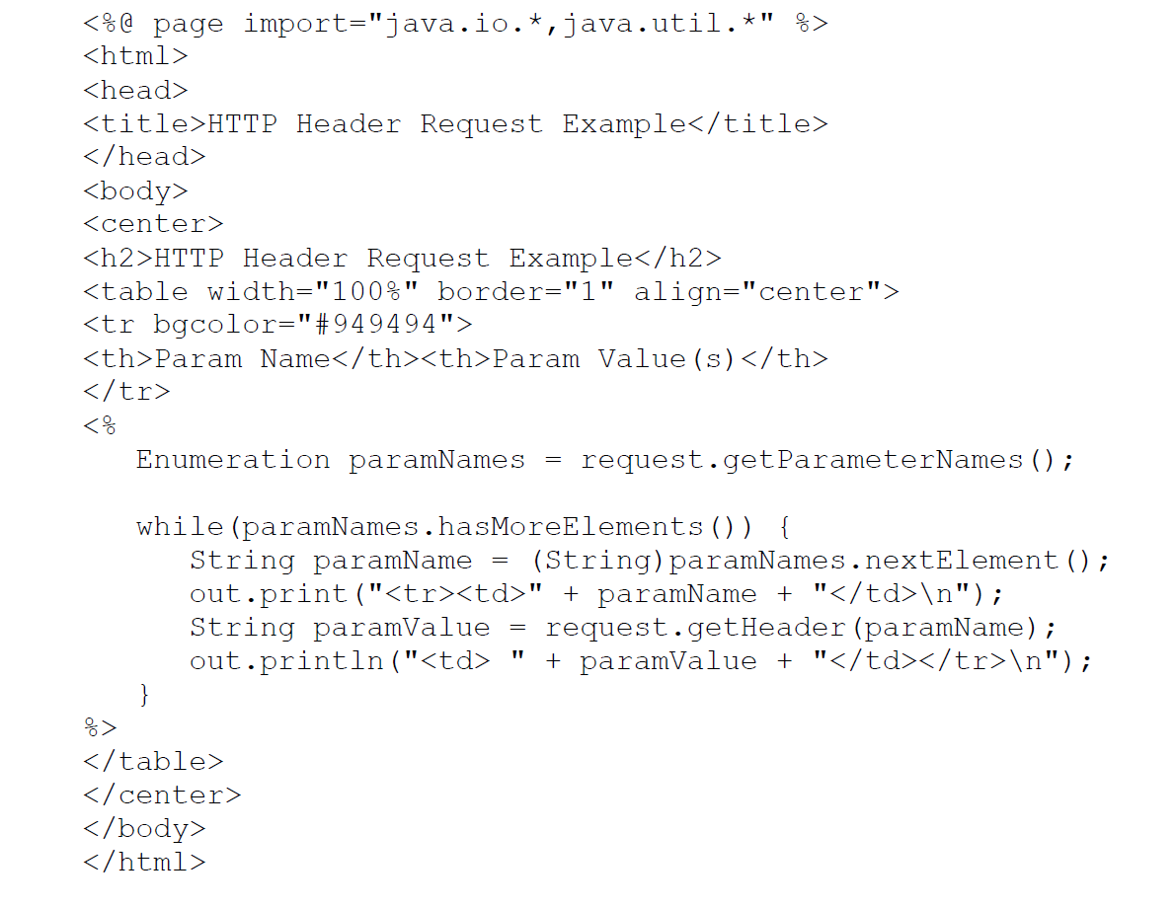

Slide 17
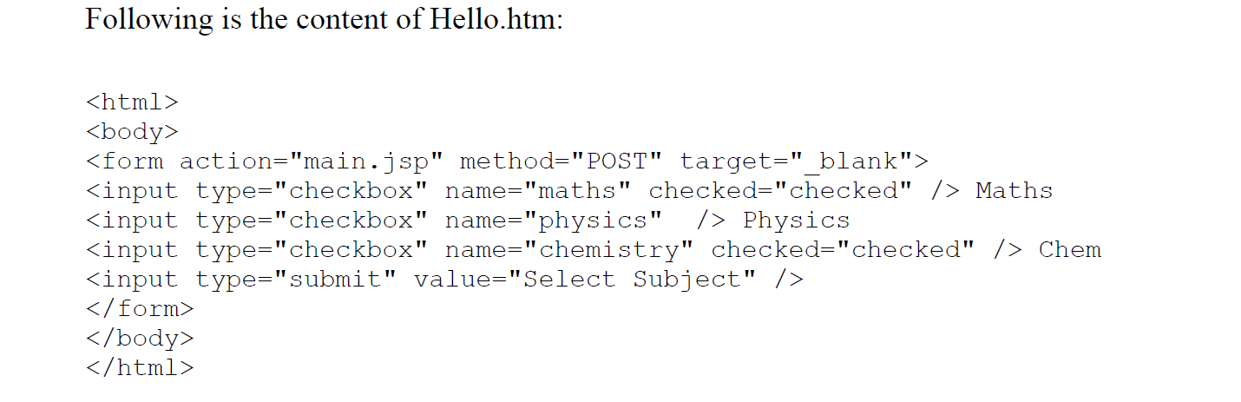

Slide 18
import javax.servlet.*;
import javax.servlet.http.*;
import java.io.*;
public class OurSrv extends HttpServlet
{
public void service(HttpServletRequest request, HttpServletResponse
response) throws ServletException, IOException
{
PrintWriter out=response.getWriter( );
System.out.println(request.getMethod( ));
System.out.println(request.getRequestURI( ));
System.out.println(request.getProtocol( ));
System.out.println(request.getHeader("User-Agent"));
out.println("executed");
}
}

Slide 19
import javax.servlet.*;
import javax.servlet.http.*;
import java.io.*;
public class DDSrv extends HttpServlet
{
public void service(HttpServletRequest request, HttpServletResponse
response) throws ServletException, IOException
{
PrintWriter out=response.getWriter( );
java.util.Date n=new java.util.Date( );
response.setContentType("text/html");
out.println(n);
}
}

Slide 20
import javax.servlet.*;
import javax.servlet.http.*;
import java.io.*;
public class Hsr extends HttpServlet
{
public void service(HttpServletRequest request, HttpServletResponse
response) throws ServletException, IOException
{
System.out.println(request.getClass( ));
System.out.println(response.getClass( ));
}
}

Slide 21
Servlet life Cycle

Slide 22
import javax.servlet.*;
import javax.servlet.http.*;
import java.io.*;
public class SOne implements Servlet
{
ServletConfig config=null;
public void init(ServletConfig config)throws ServletException
{
this.config=config;
System.out.println("----init----");
}
public ServletConfig getServletConfig( )
{
return this.config;
}
public void service(ServletRequest req,ServletResponse resp)
throws ServletException, IOException
{
HttpServletRequest request=(HttpServletRequest)req;
HttpServletResponse response=(HttpServletResponse)resp;
System.out.println("----service----");
}
public String getServletInfo( )
{
return "srv impliments to learn srv basics;Author:student";
}
public void destroy( )
{
this.config=null;
System.out.println("----destroy----");
}
}

Slide 23
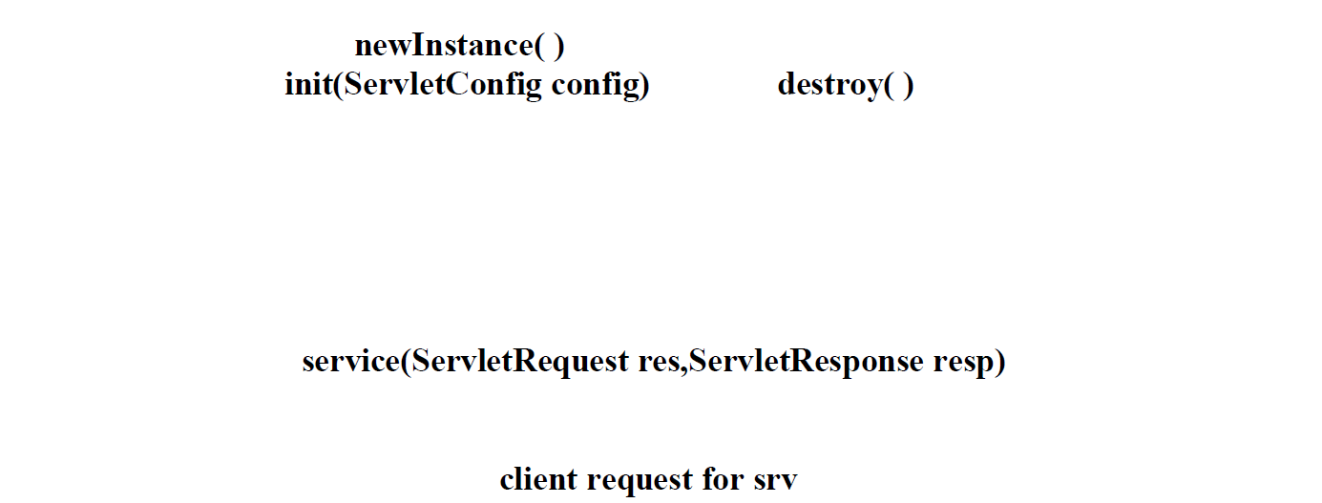

Slide 24
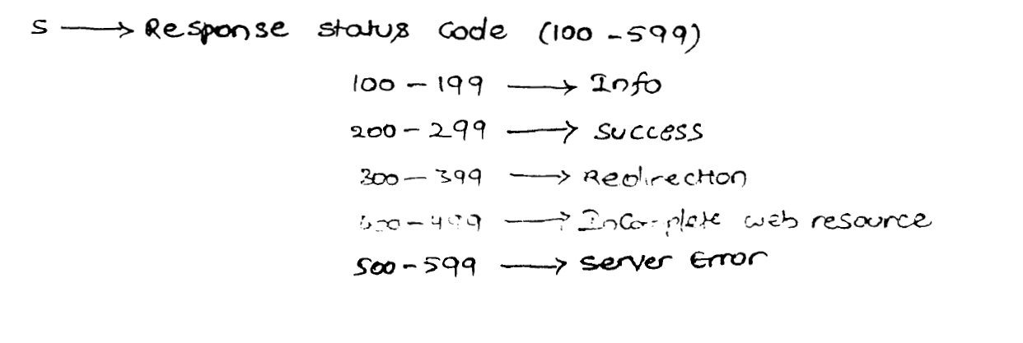

Slide 25
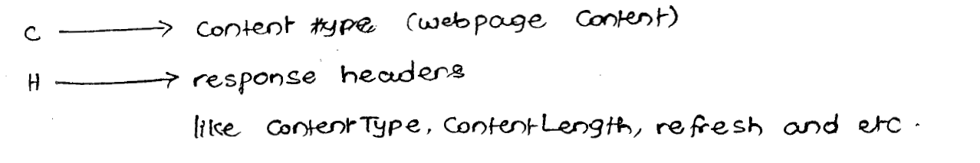

Slide 26
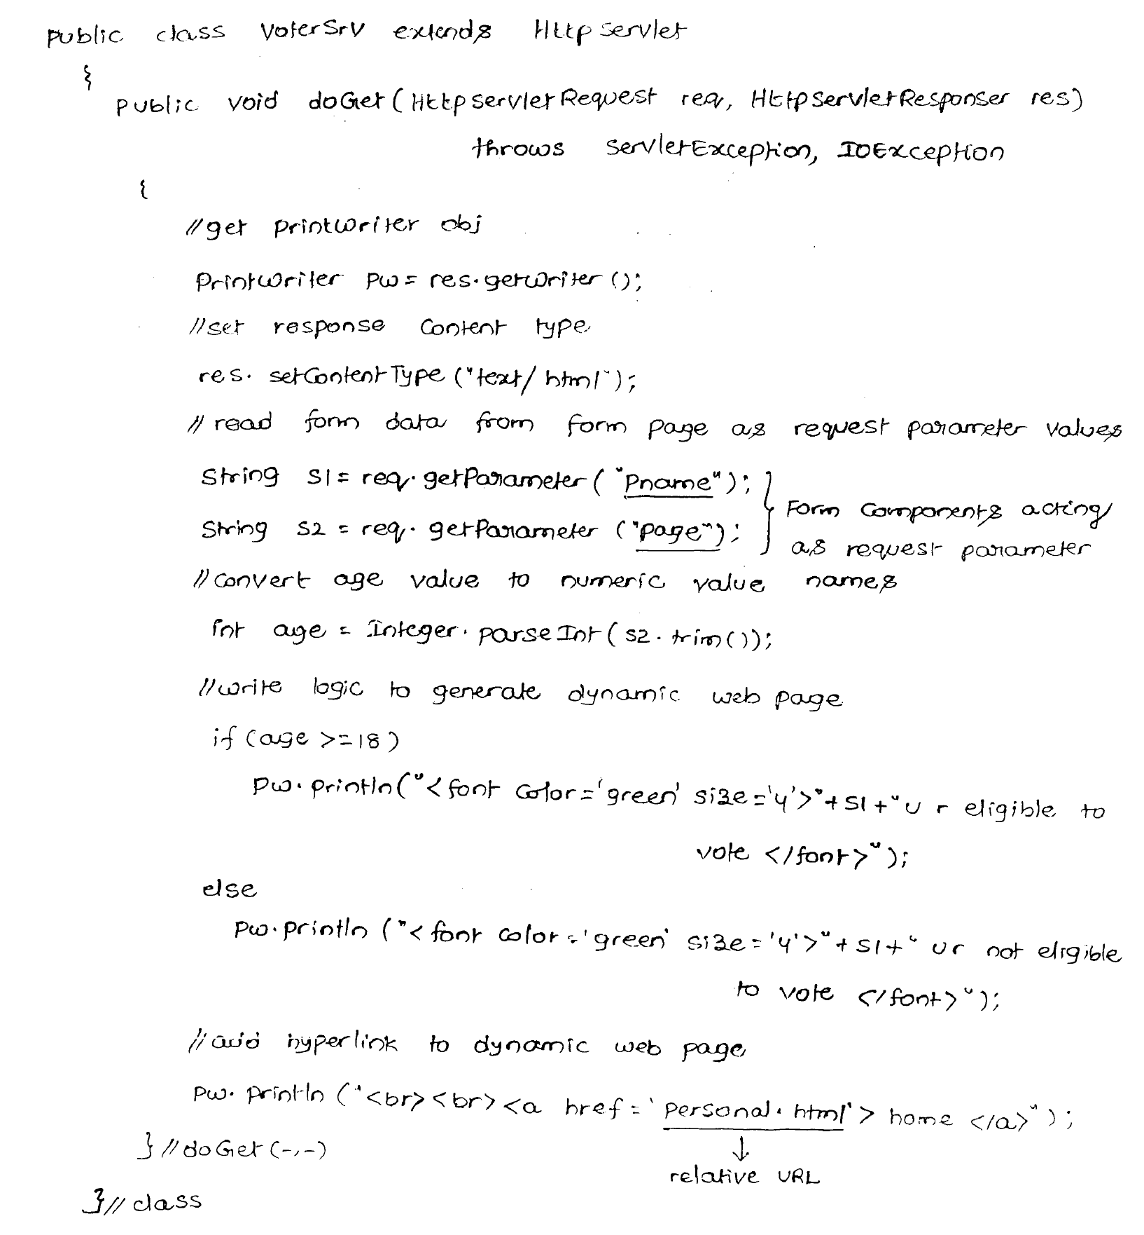

Slide 27
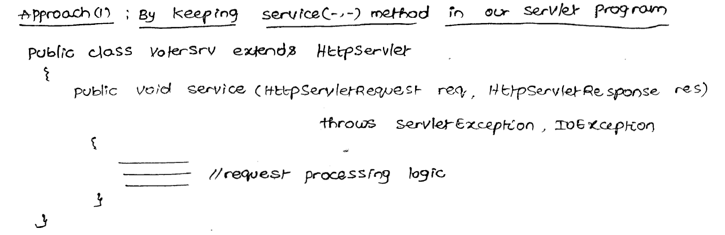

Slide 28
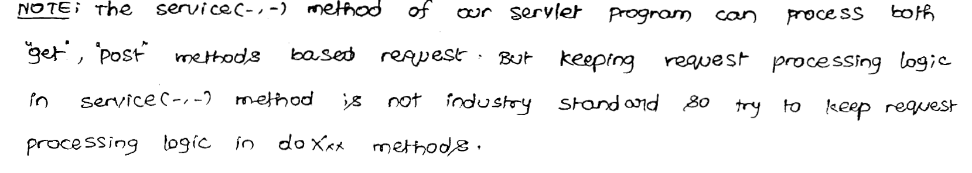

Slide 29
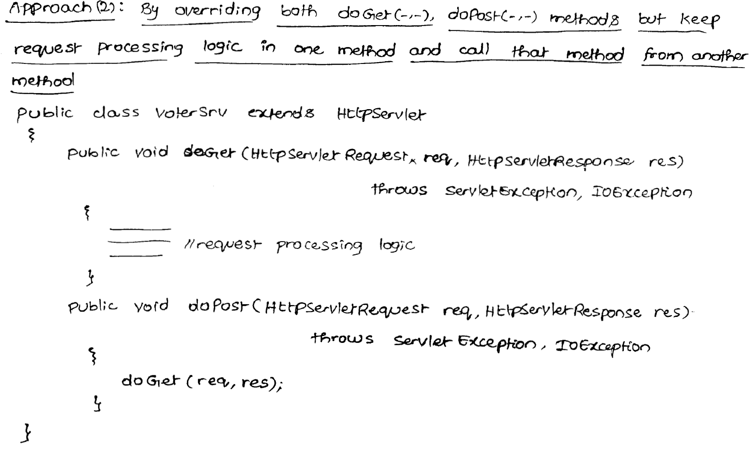

Slide 30
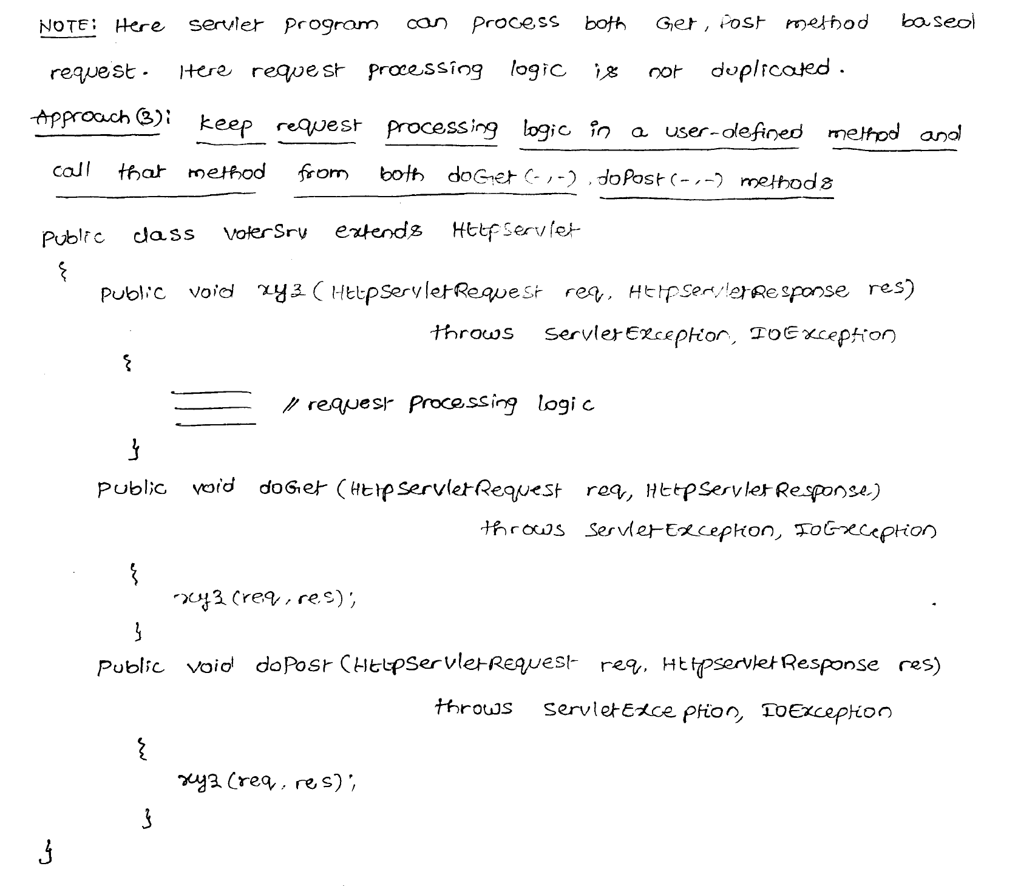

Slide 31
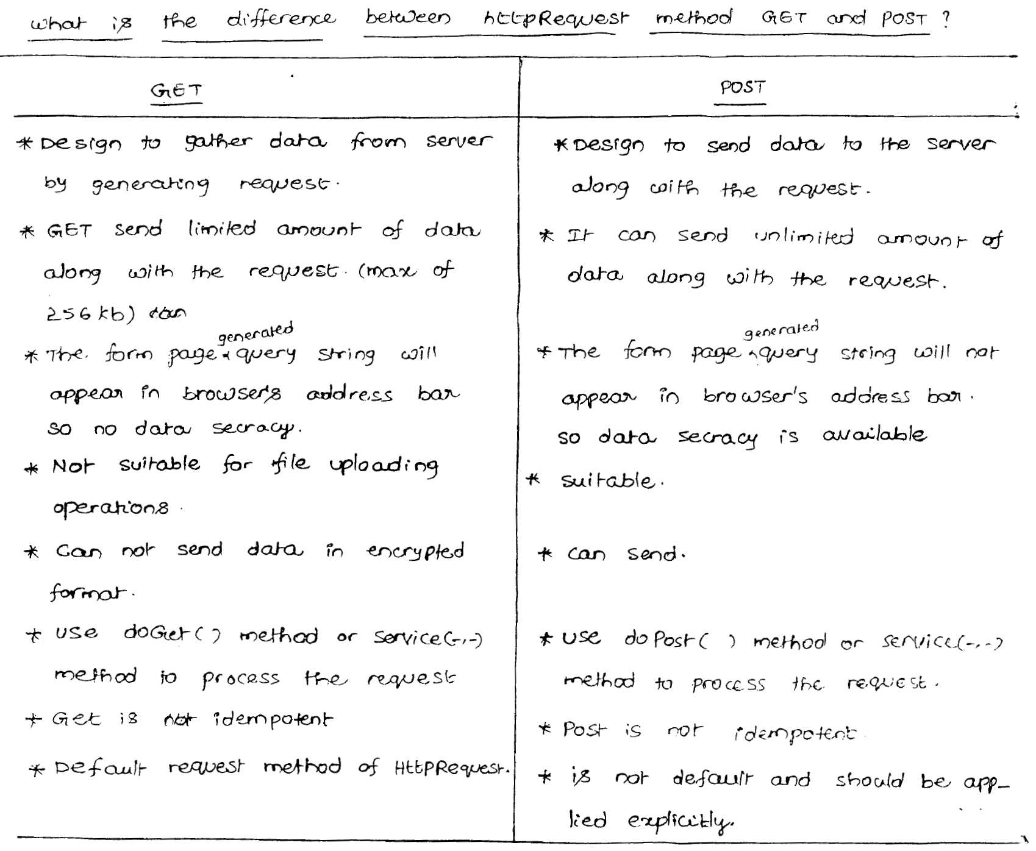

Slide 32
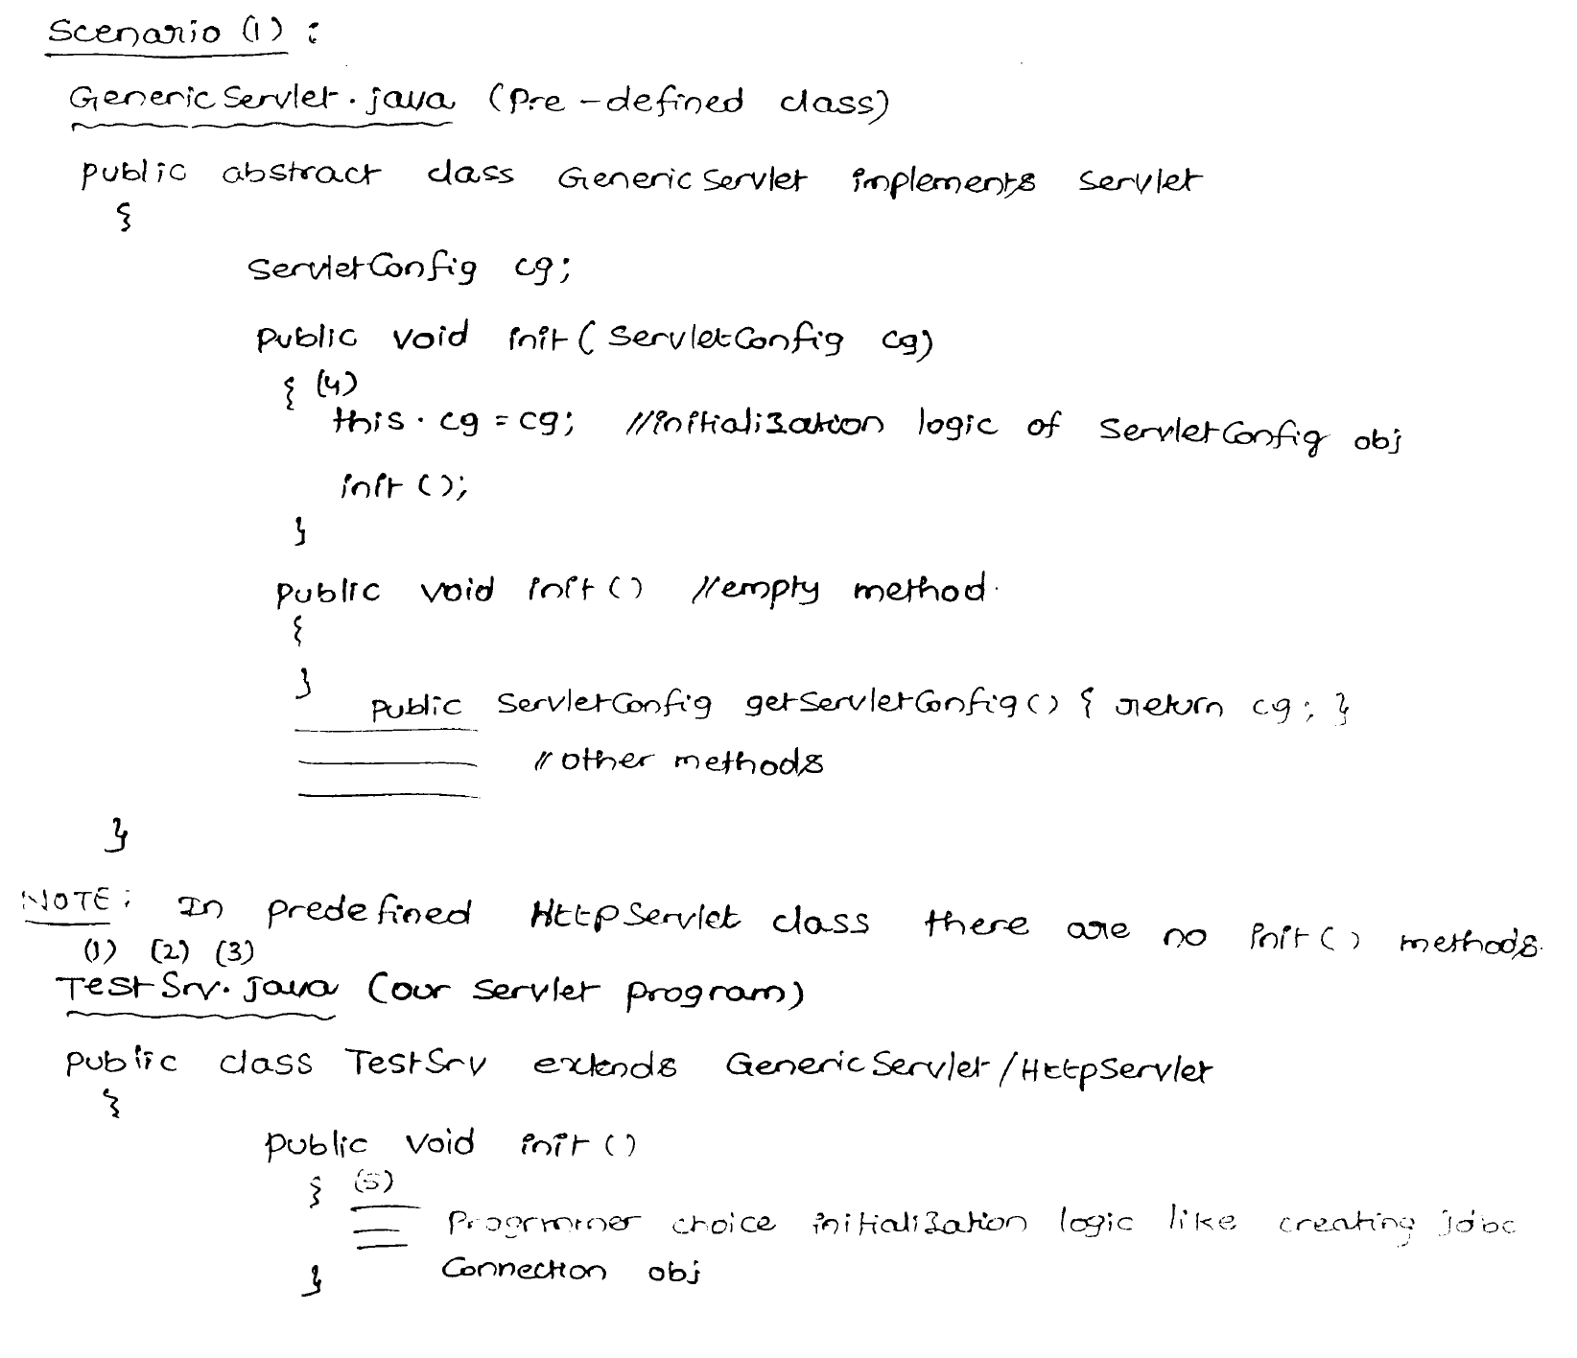

Slide 33
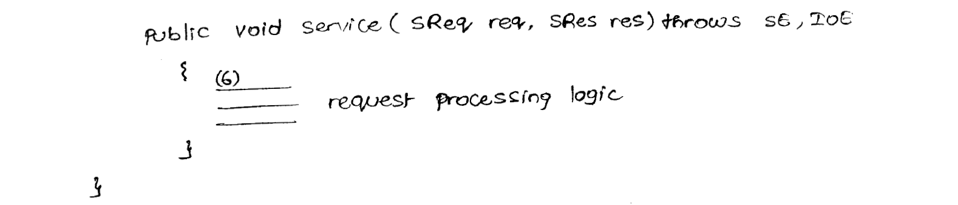

Slide 34
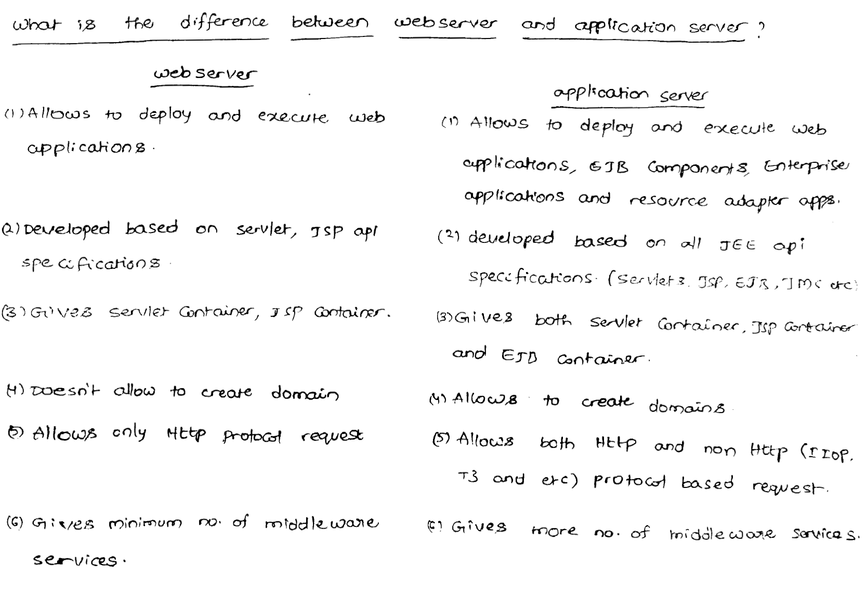

Slide 35
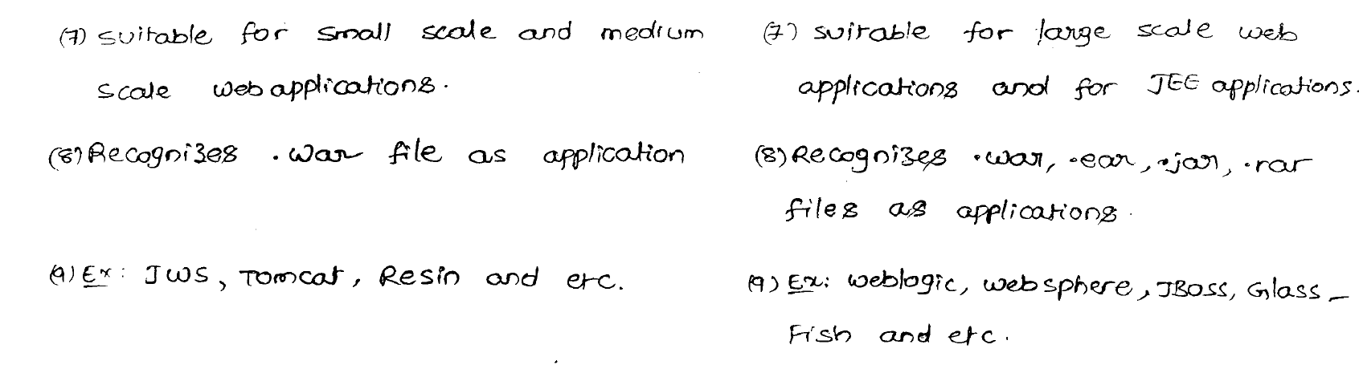

Slide 36
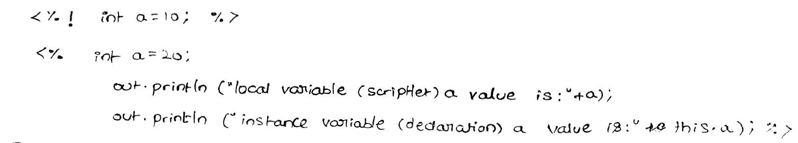

Slide 37
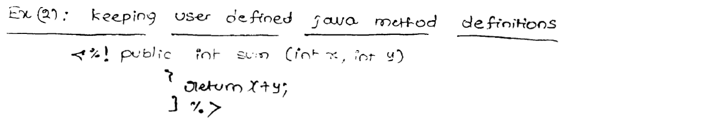

Slide 38
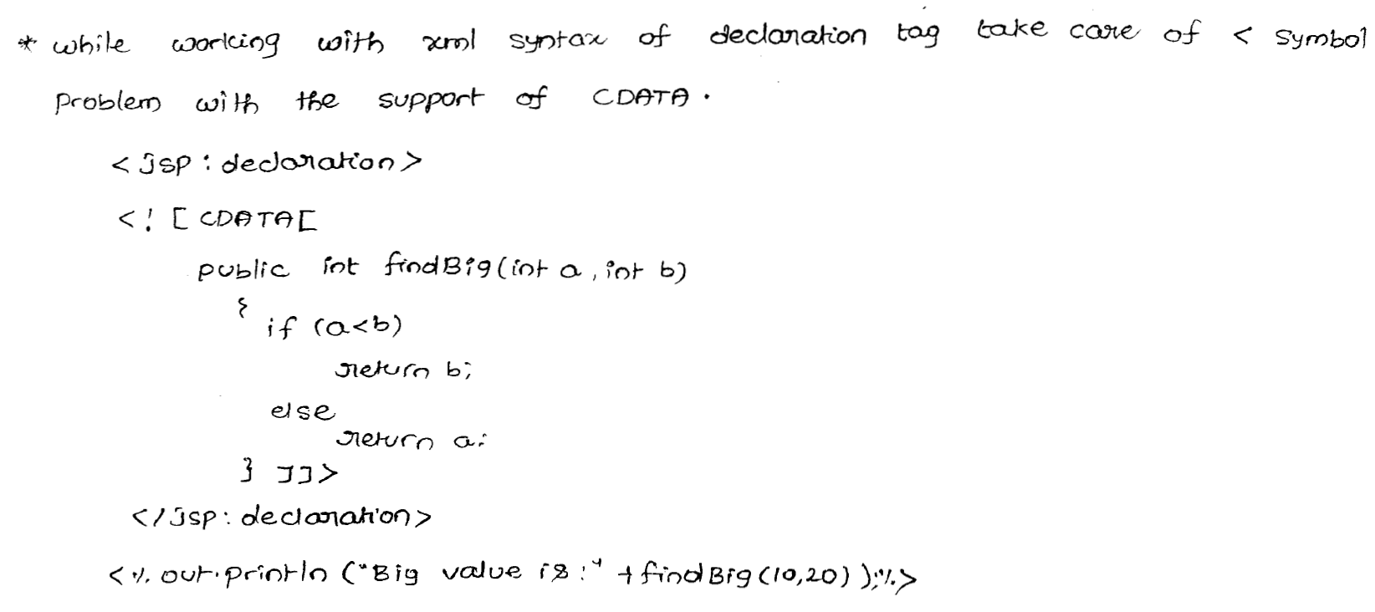

Slide 39
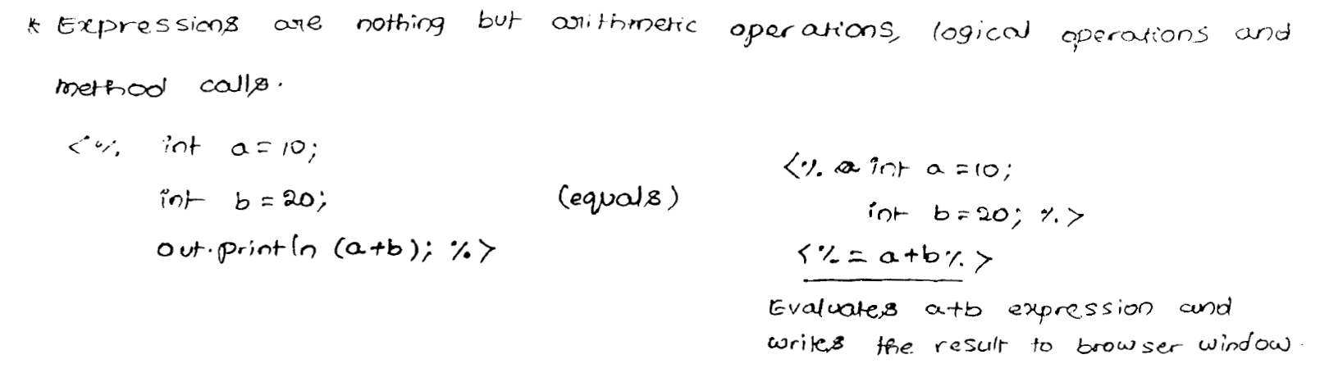

Slide 40
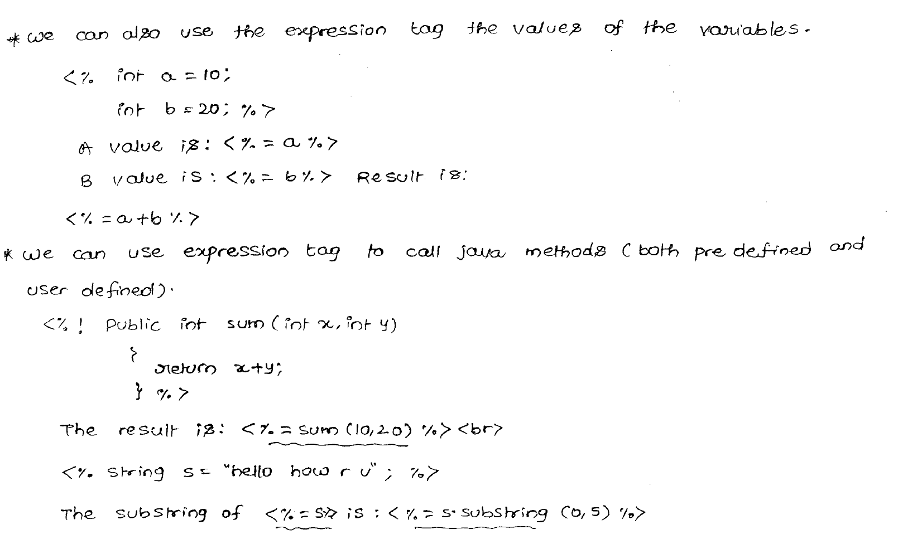

Slide 41
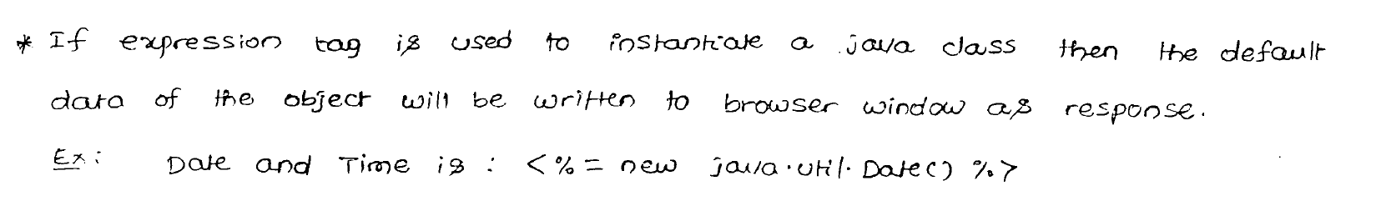

Slide 42
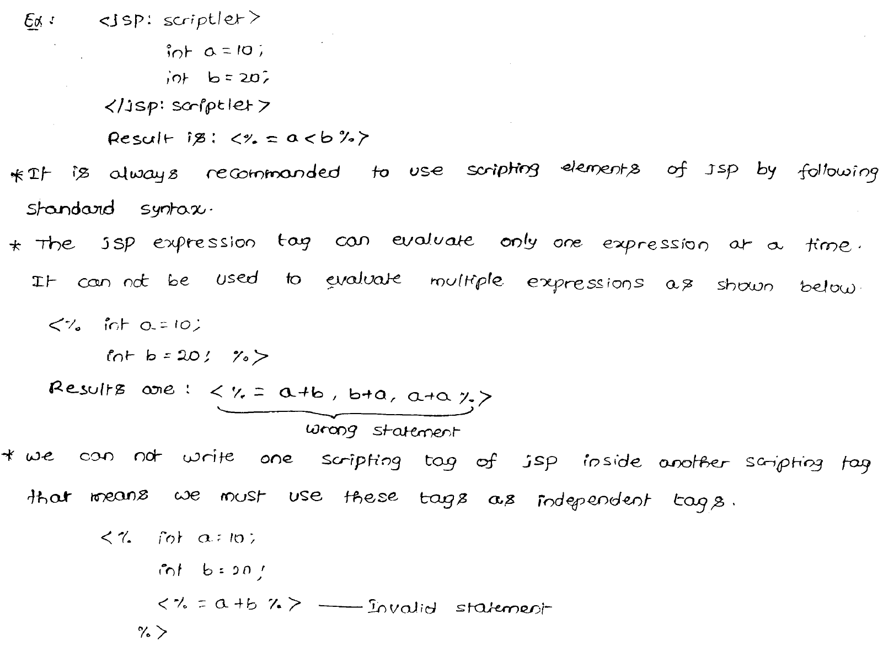

Slide 43
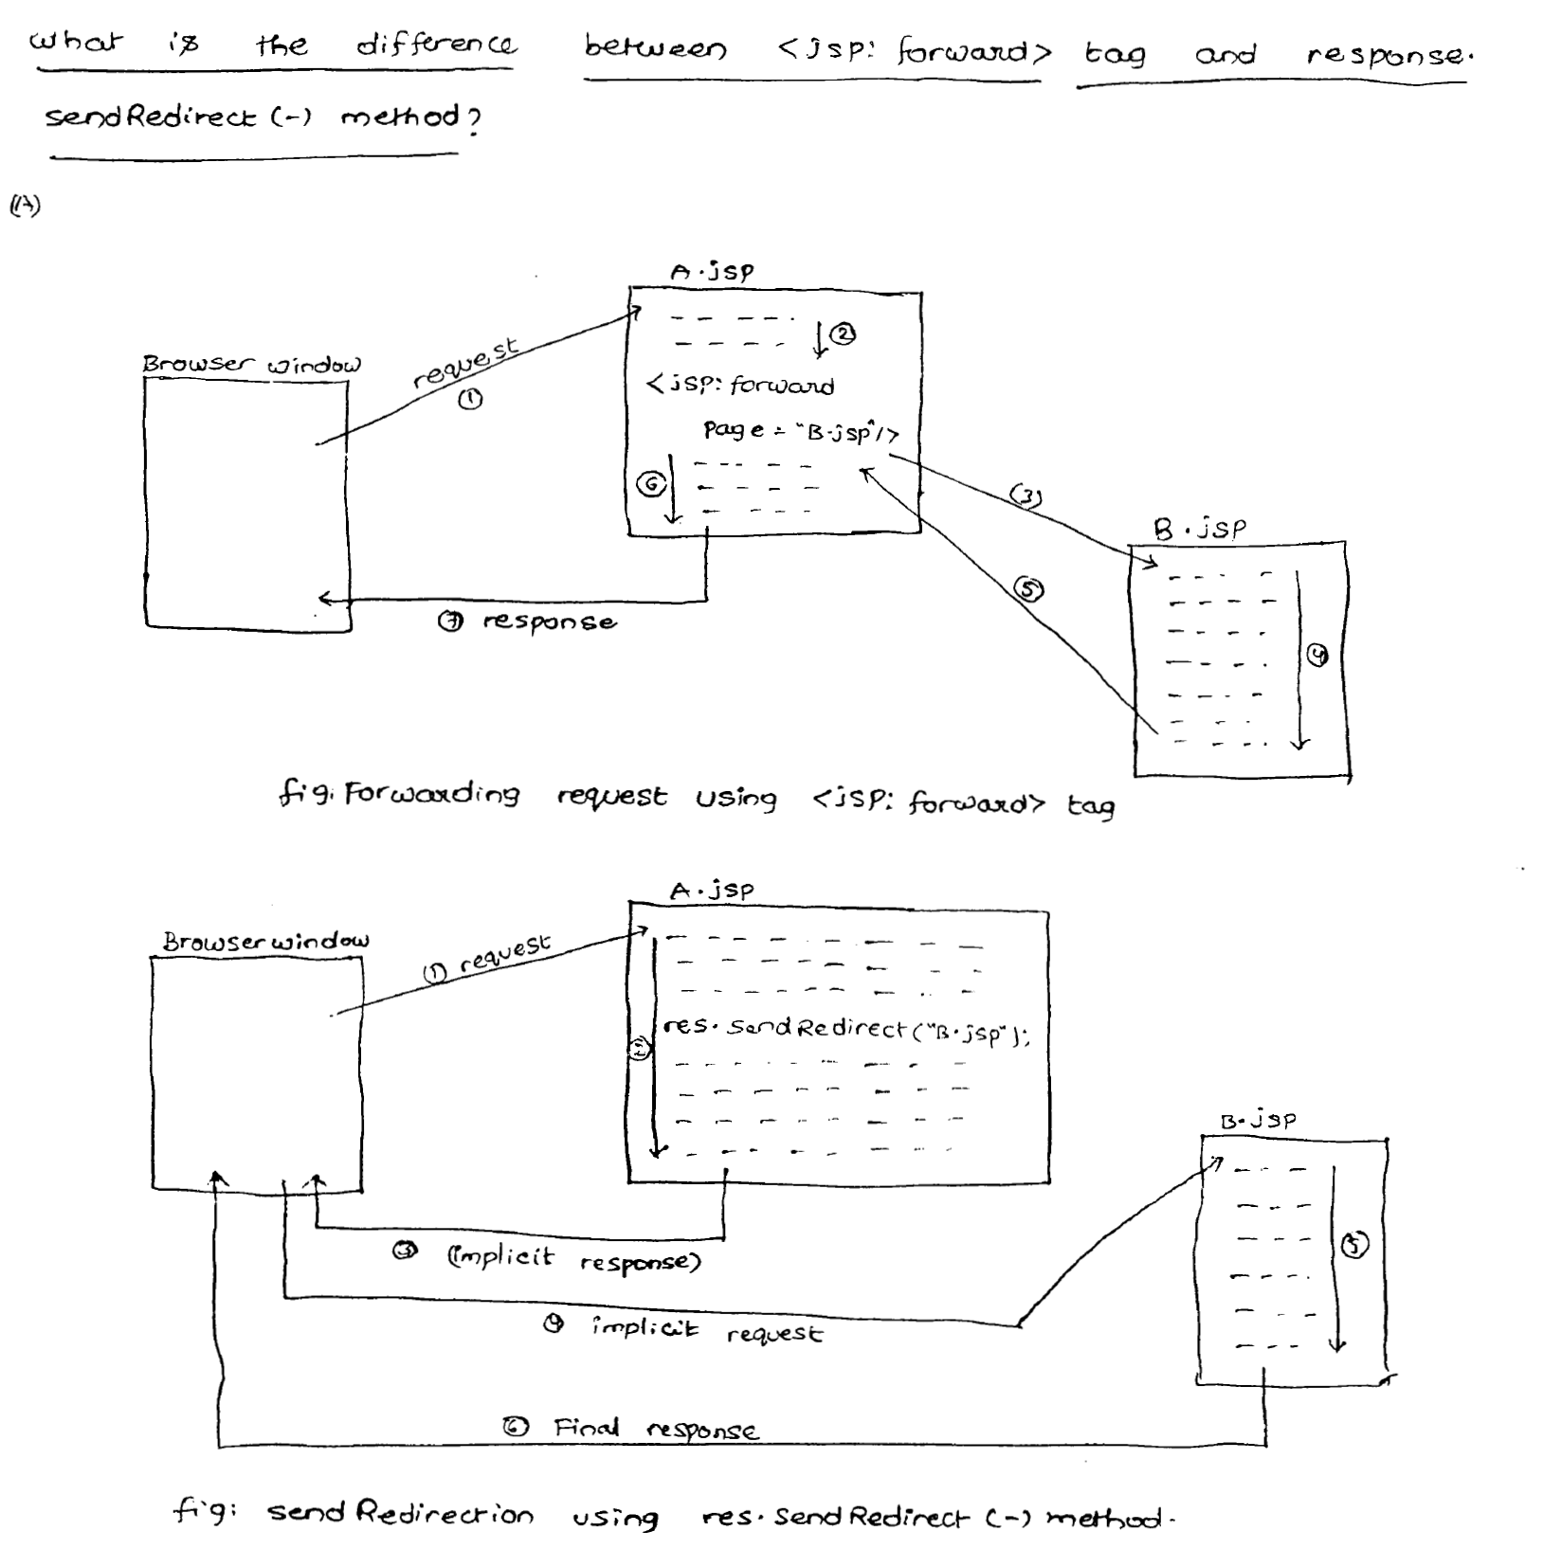

Slide 44
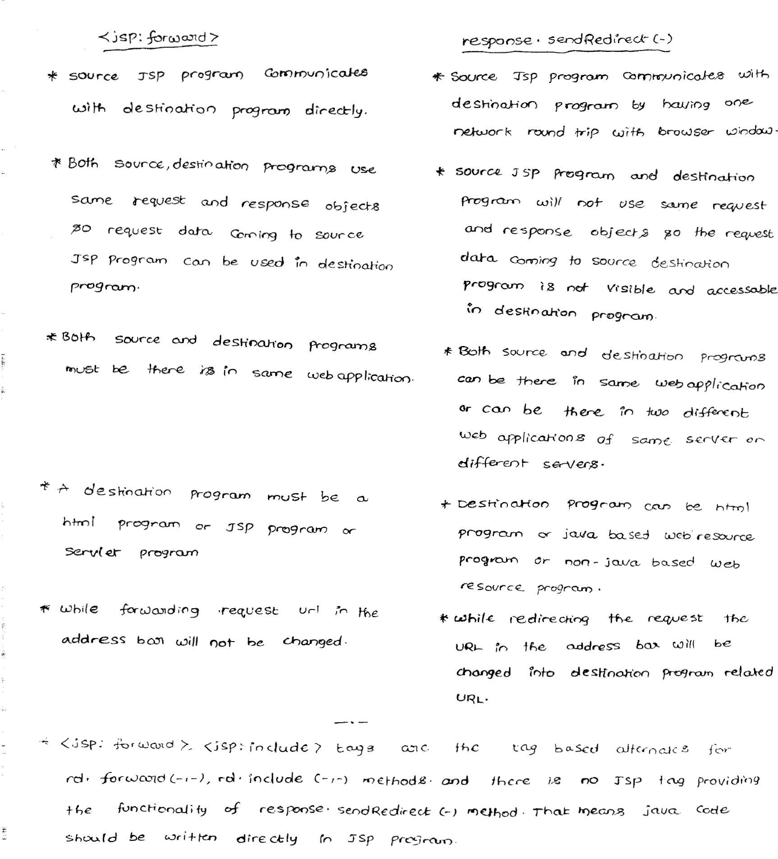

Slide 45
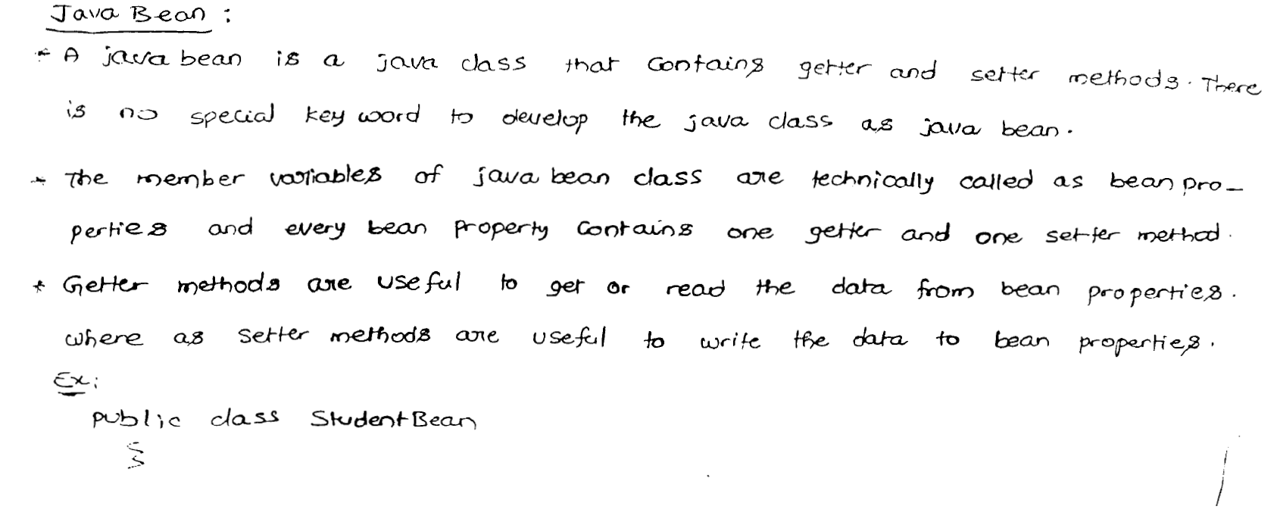

Slide 46
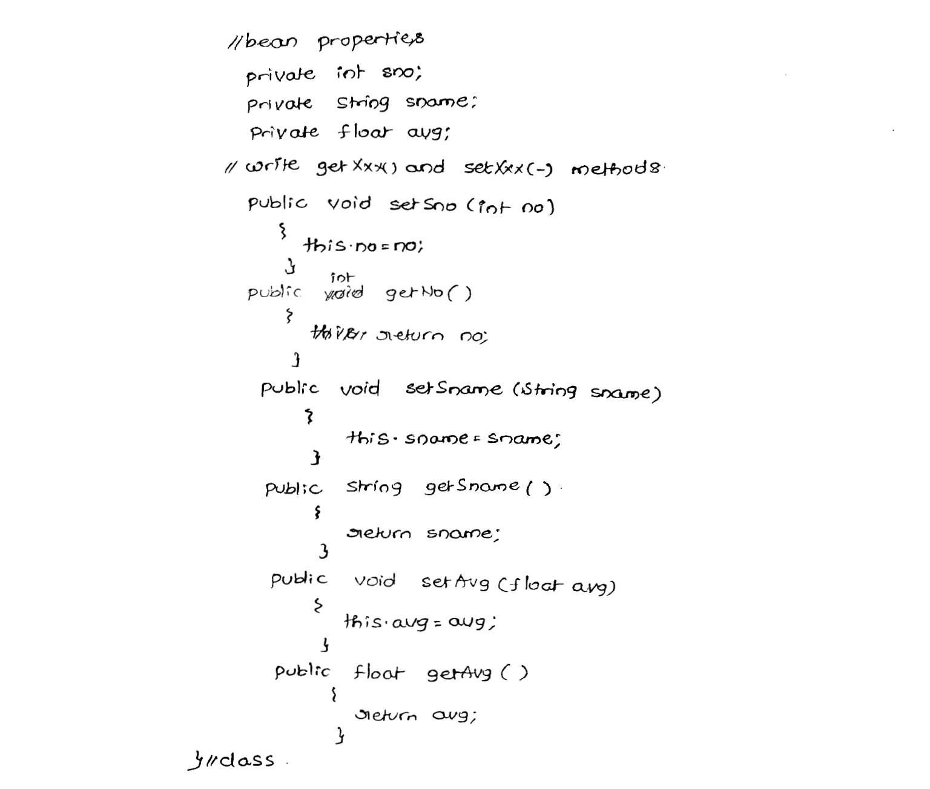

Slide 47
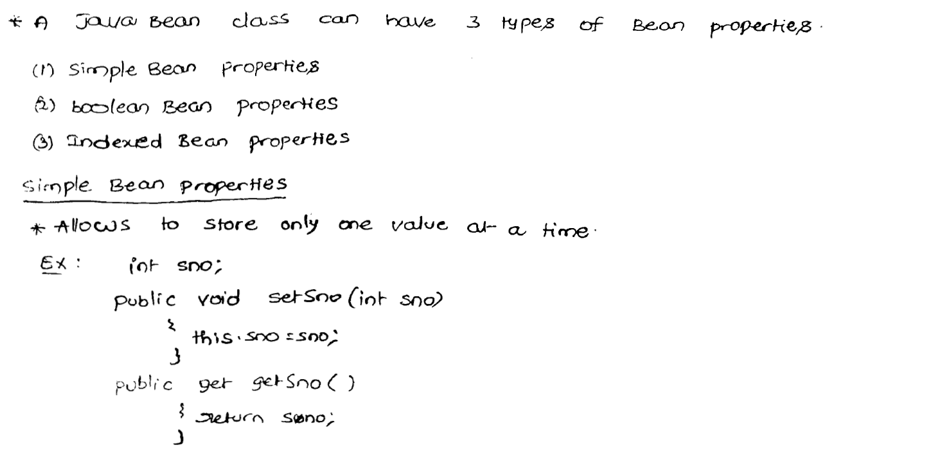

Slide 48
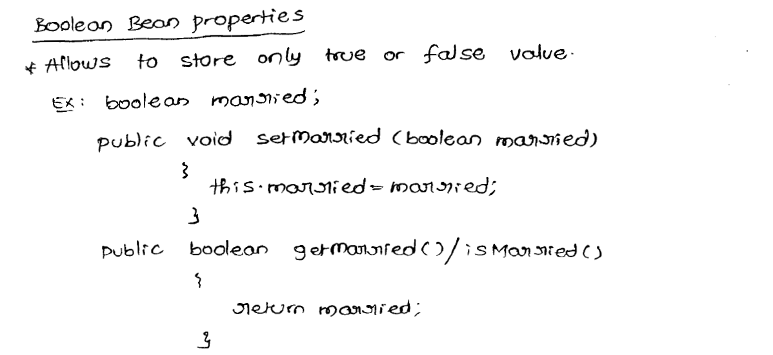

Slide 49
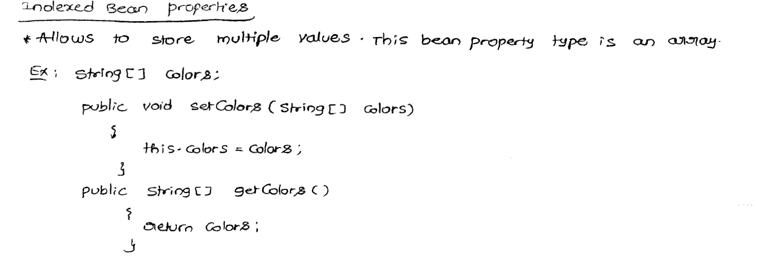

Slide 50
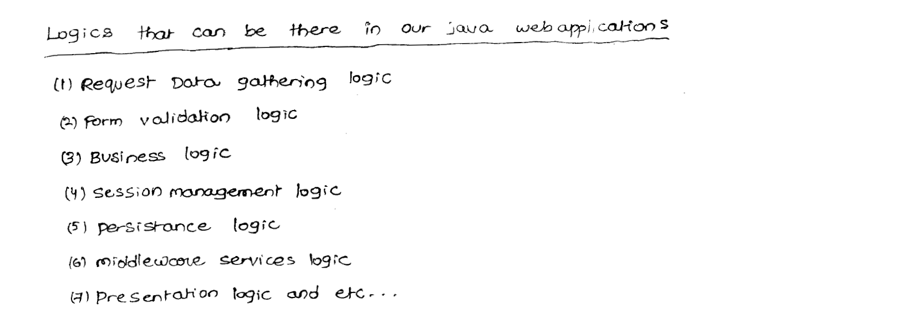

Slide 51
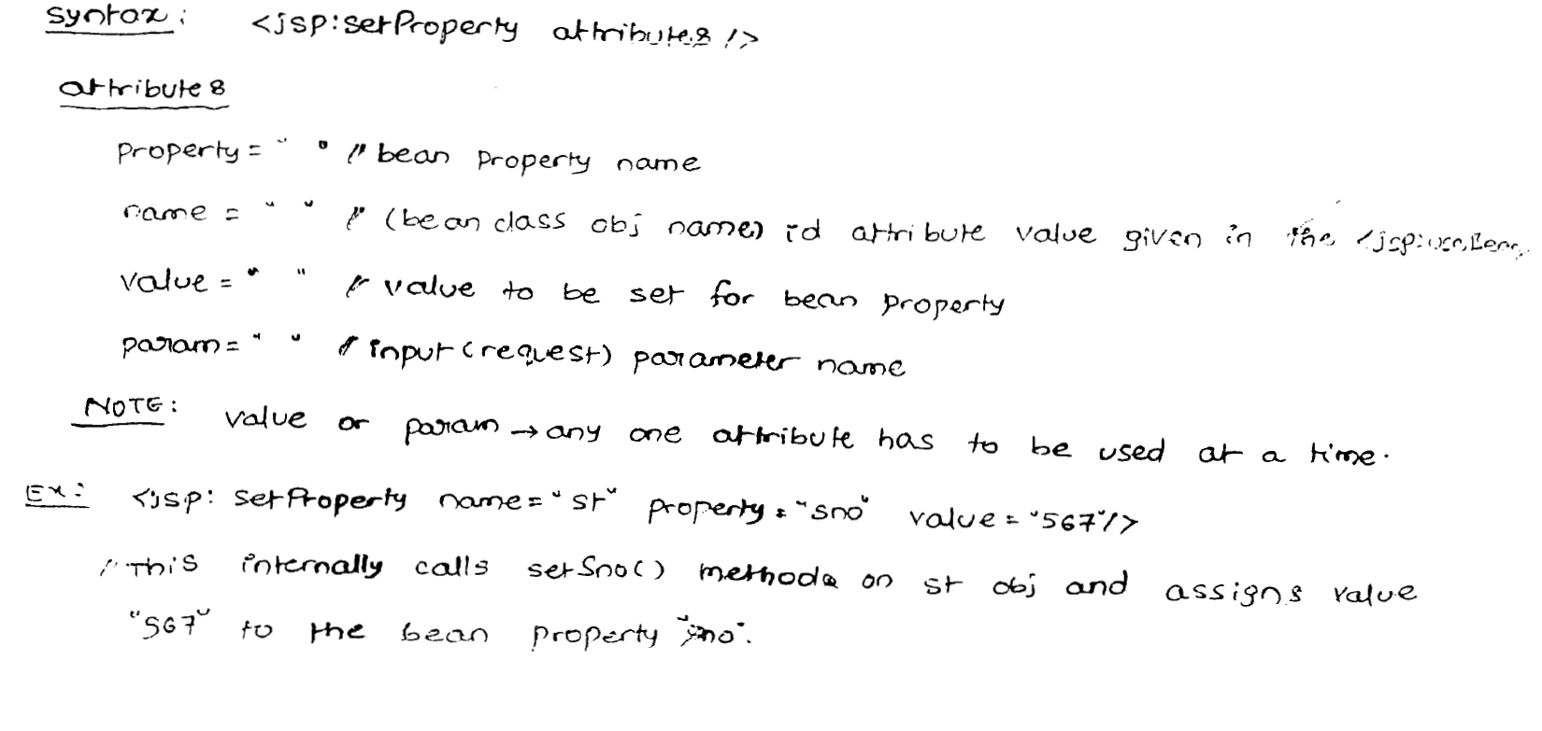

Slide 52
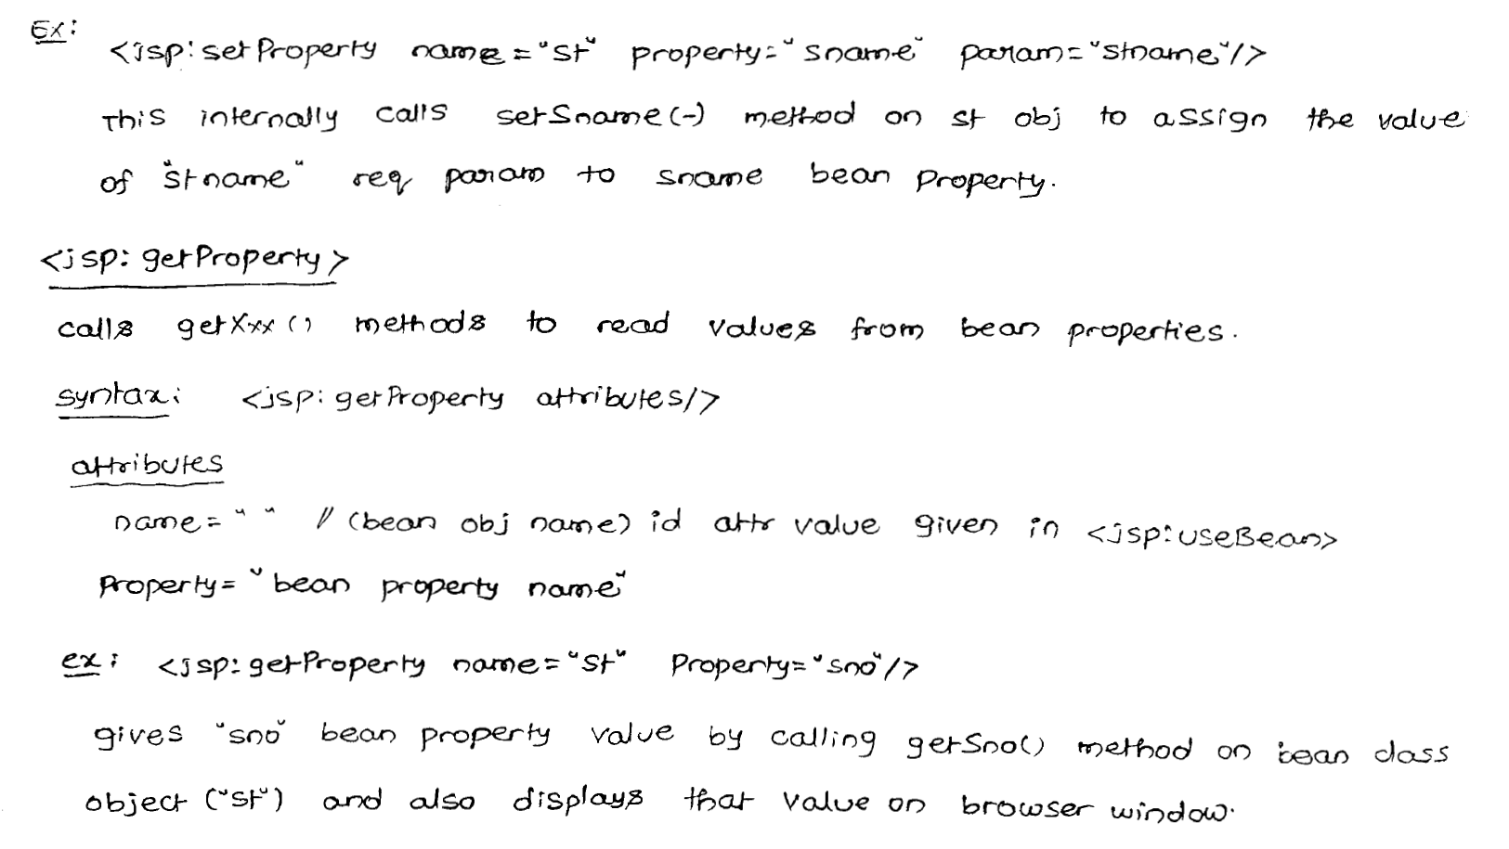

Slide 53
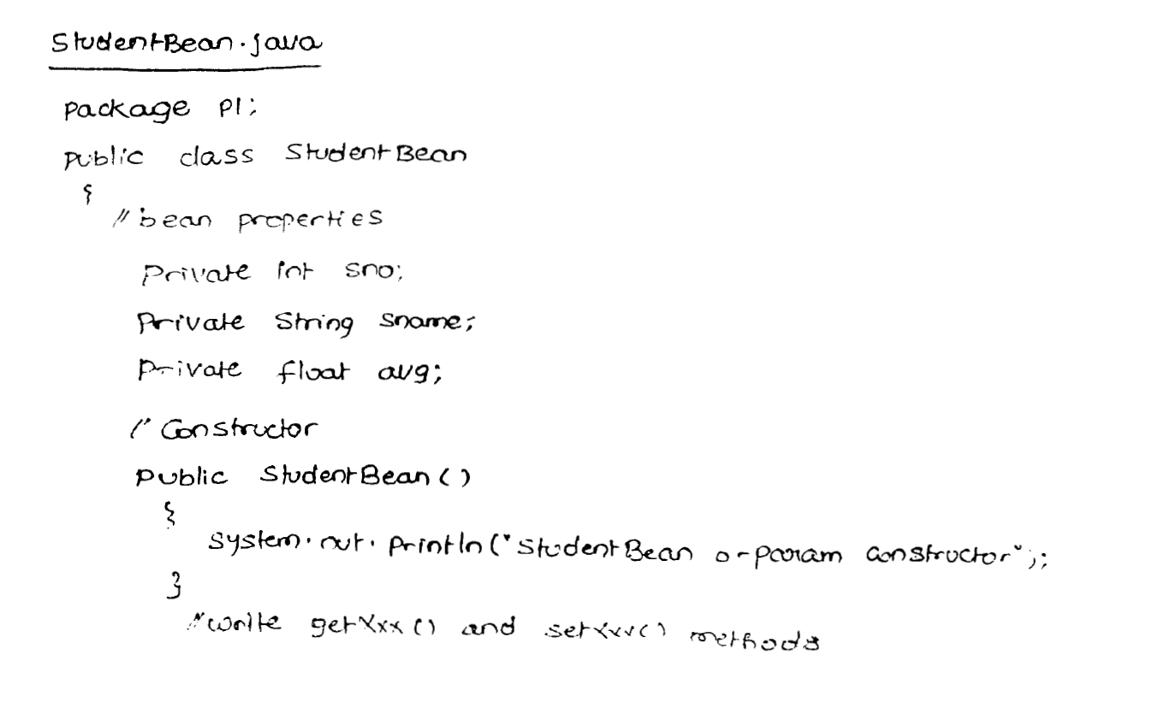

Slide 54
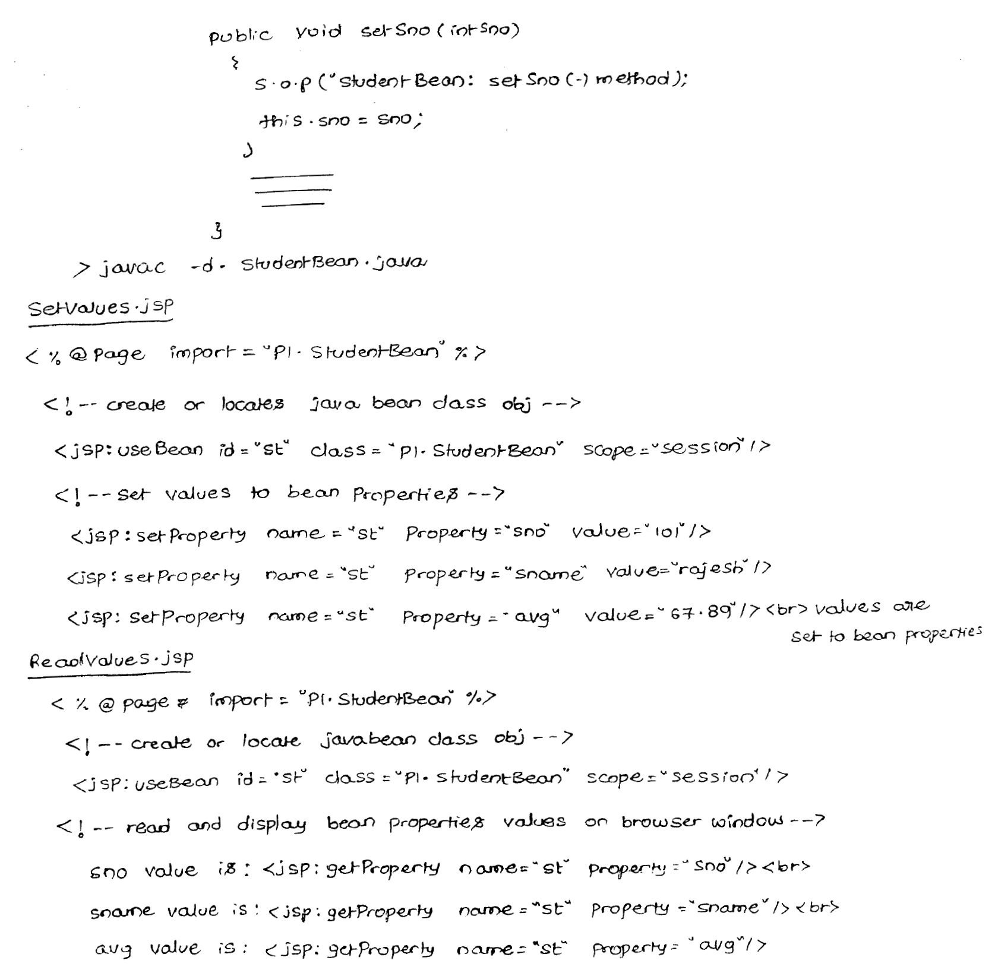

Slide 55
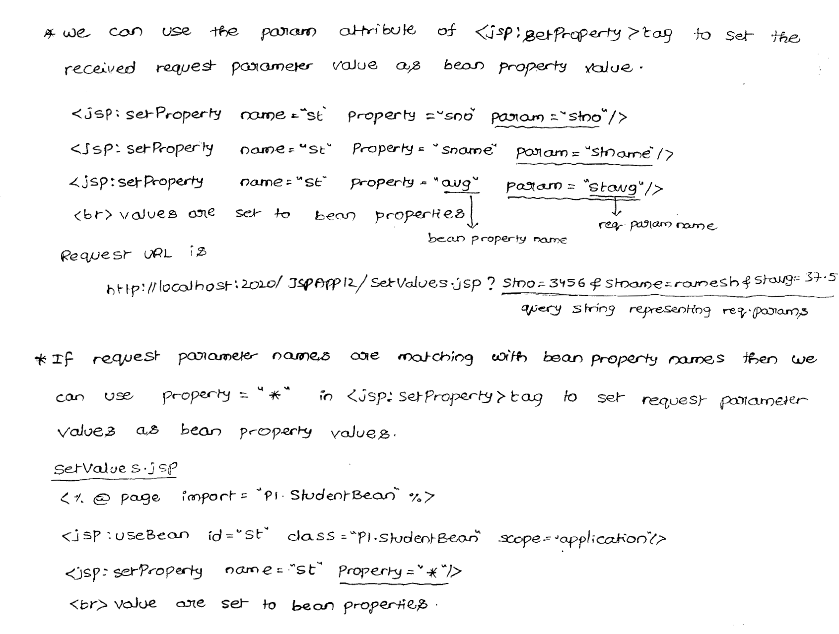

Slide 56
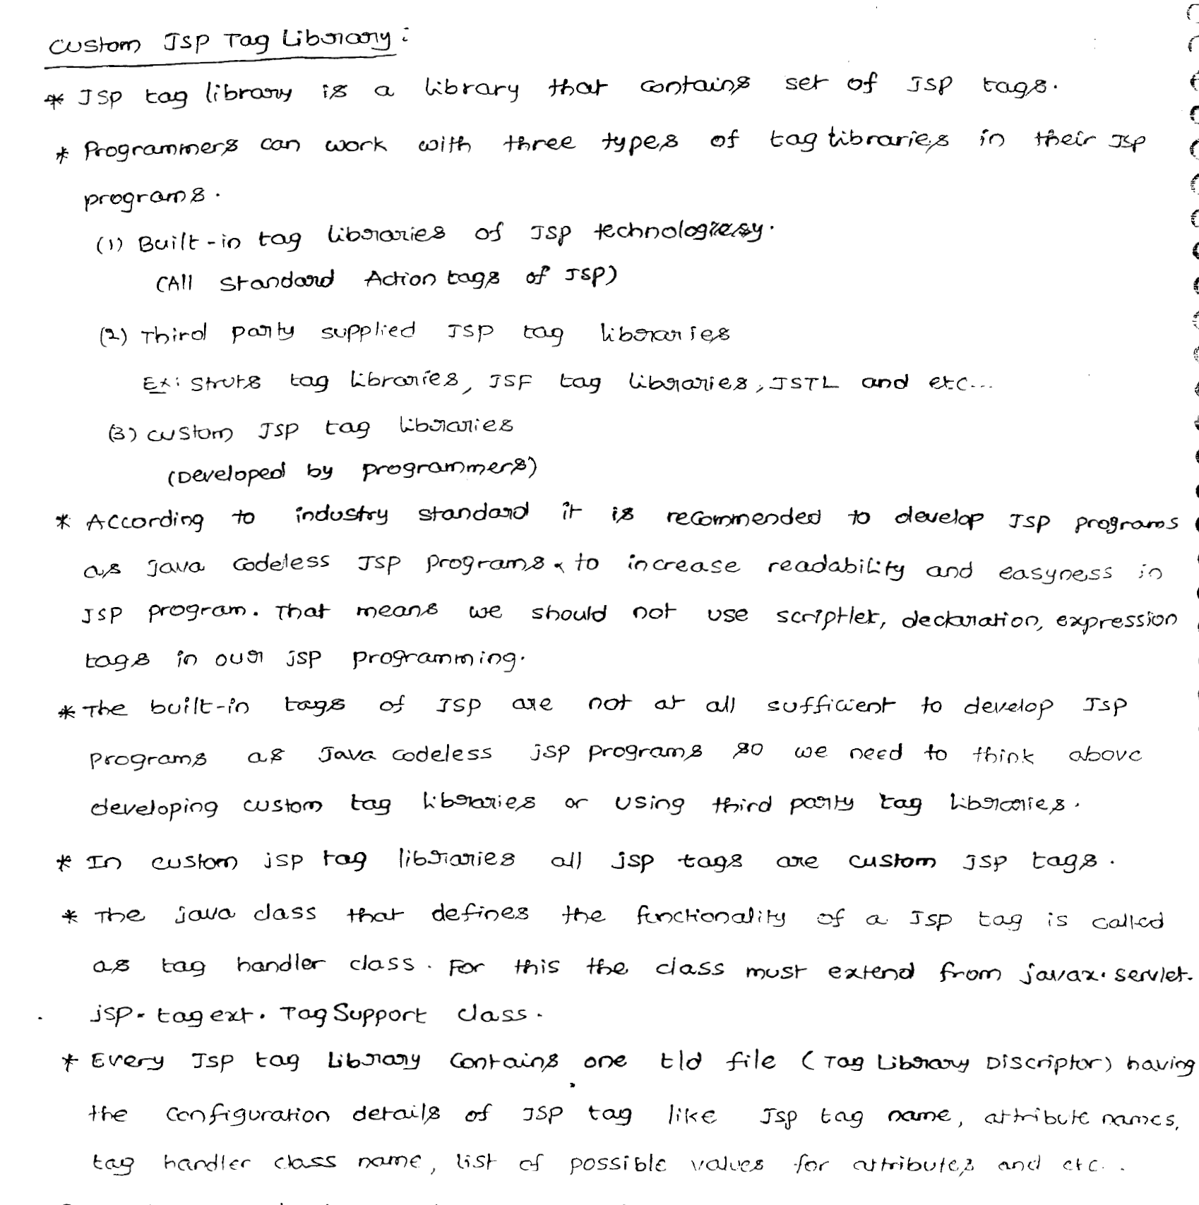

Slide 57
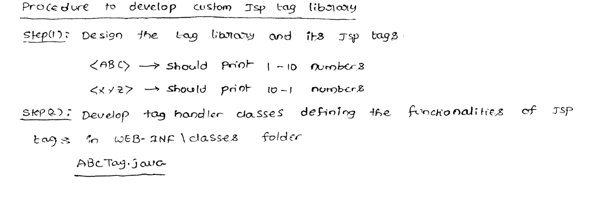

Slide 58
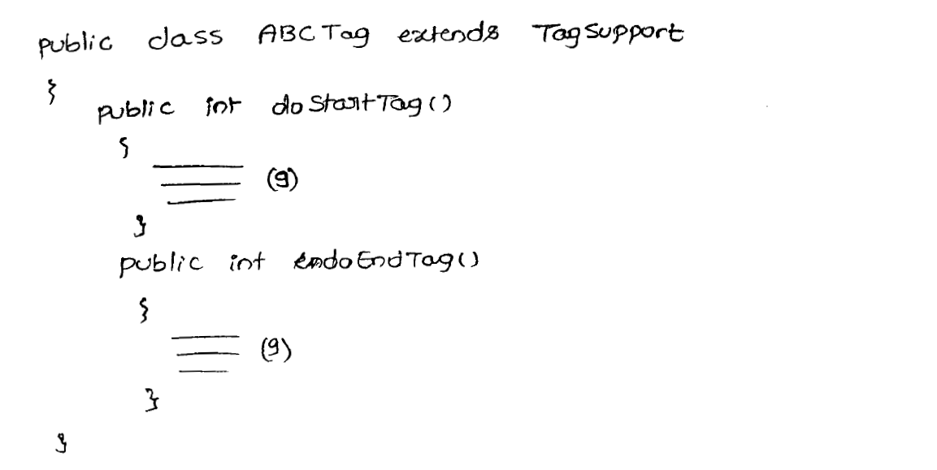

Slide 59
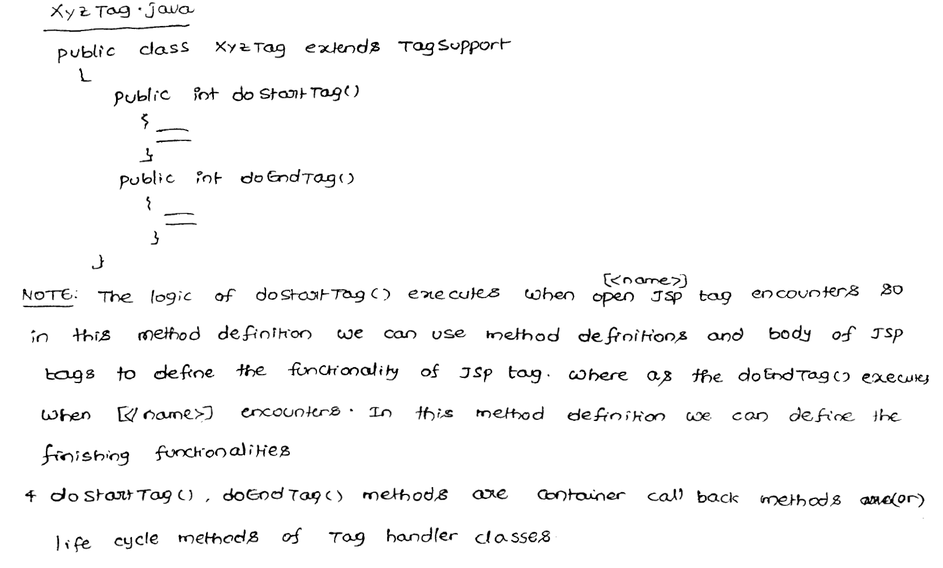

Slide 60
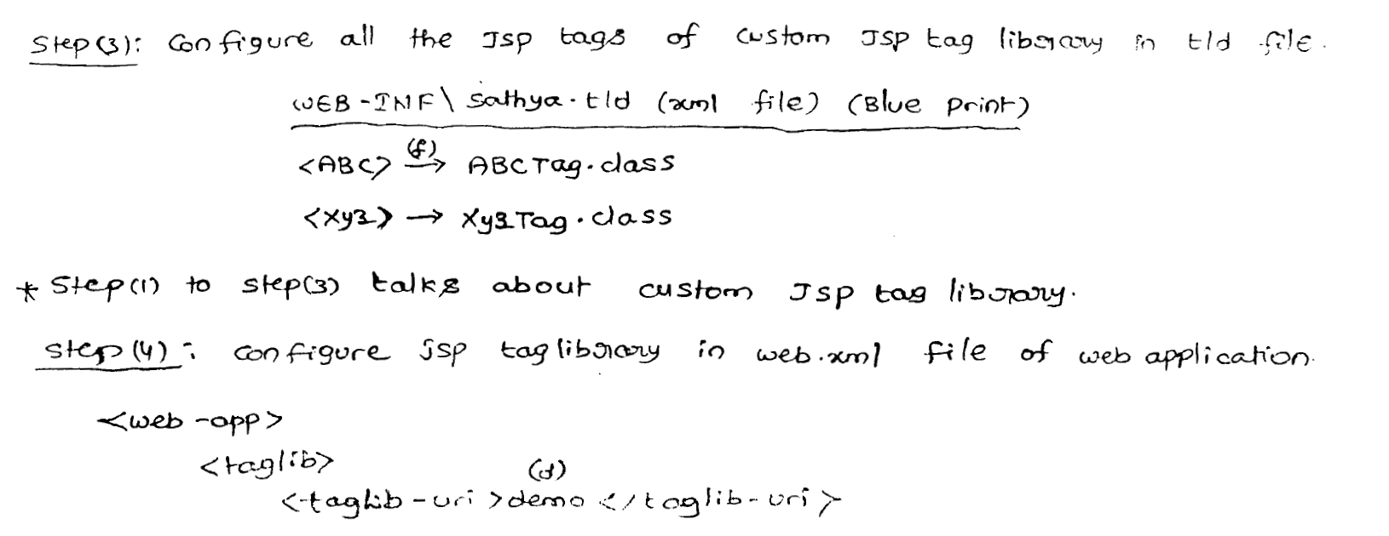

Slide 61
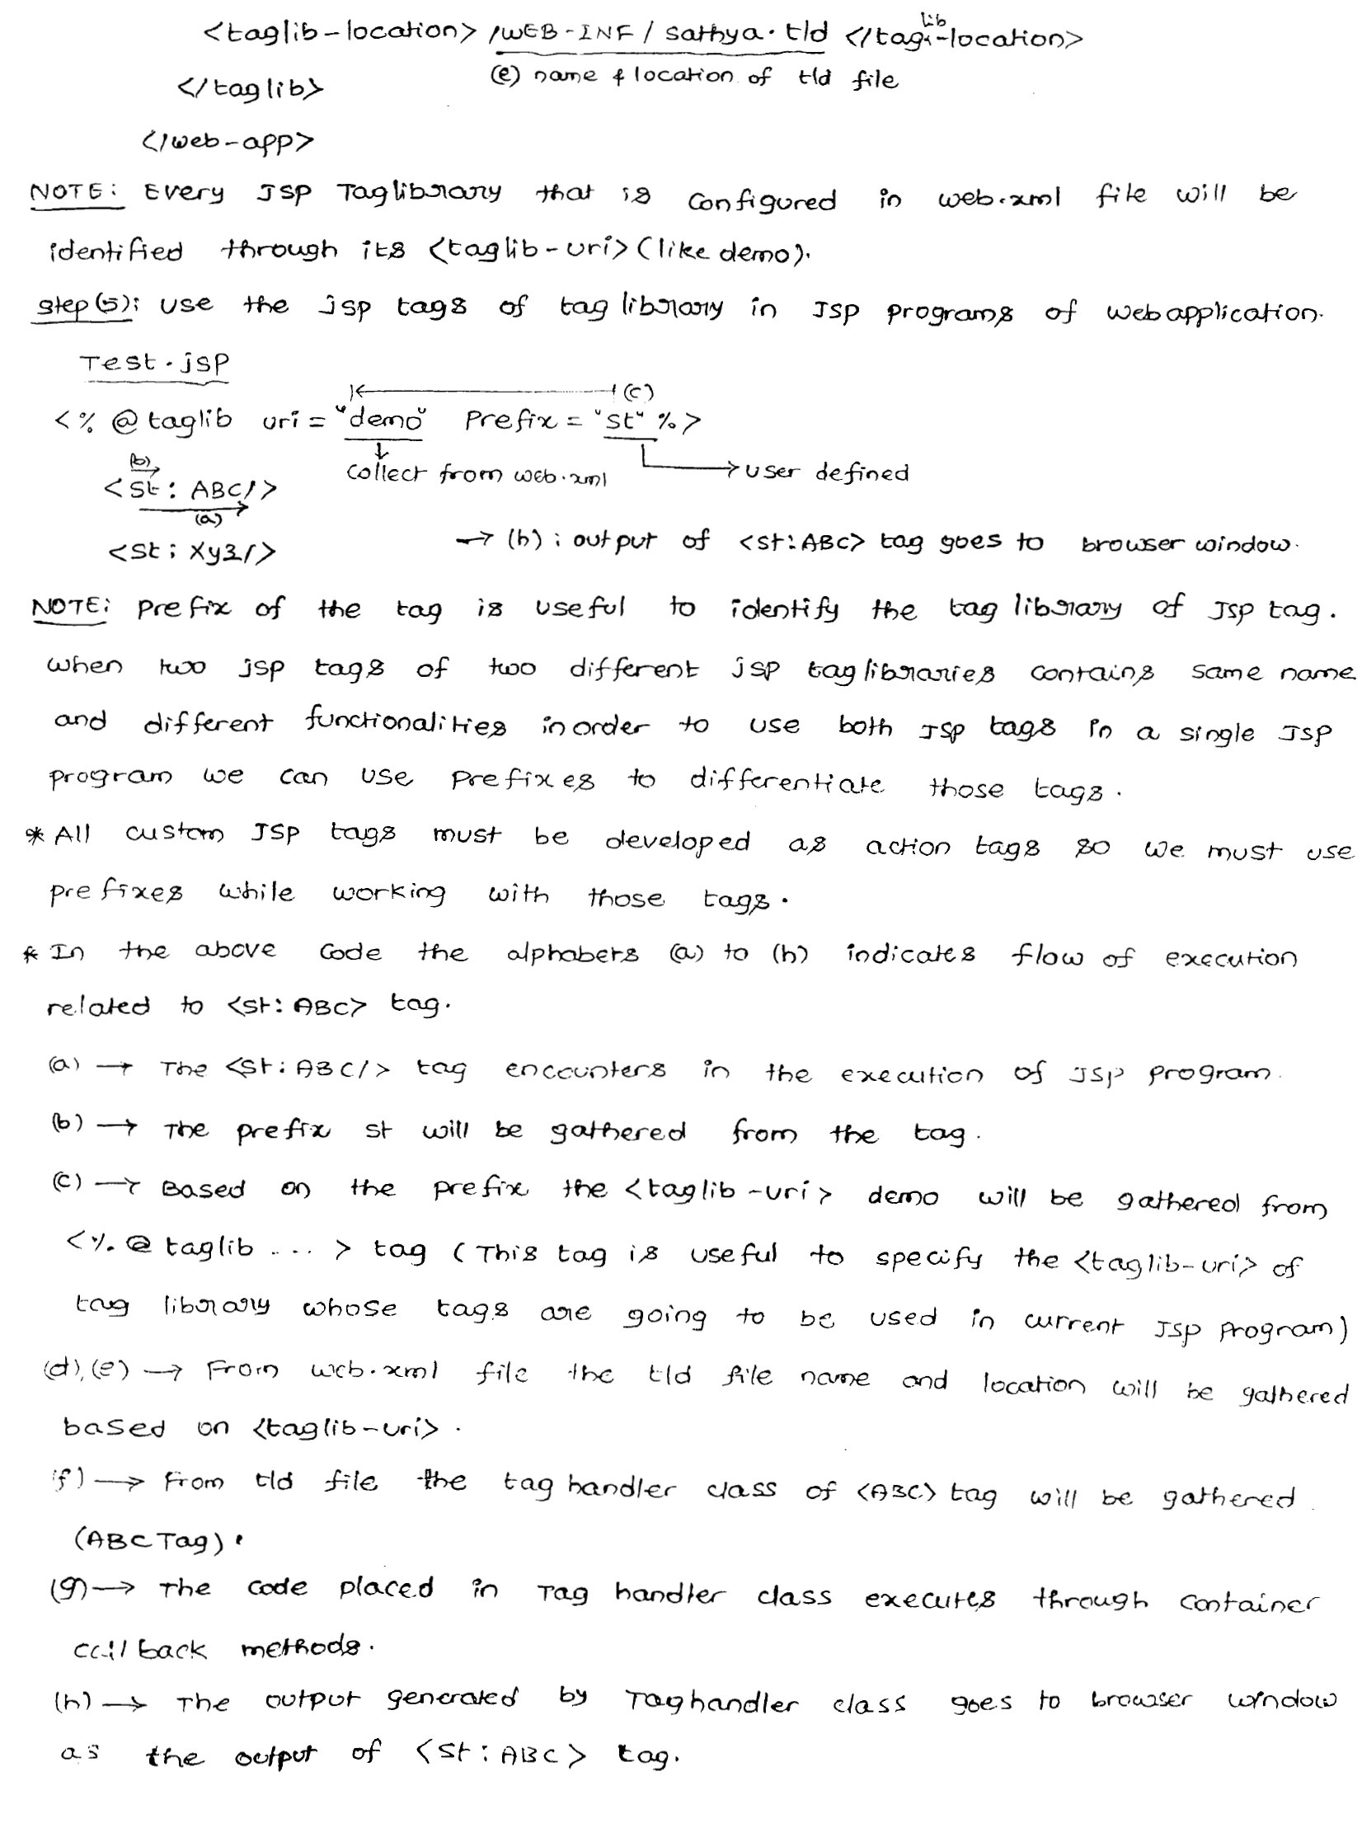

Slide 62
